Slide 1
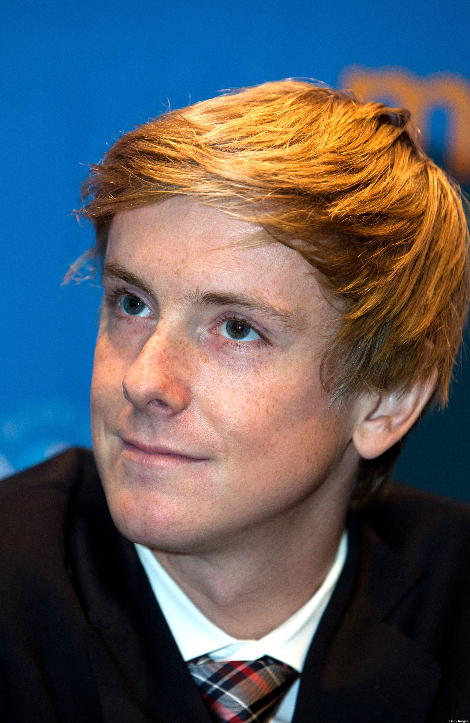

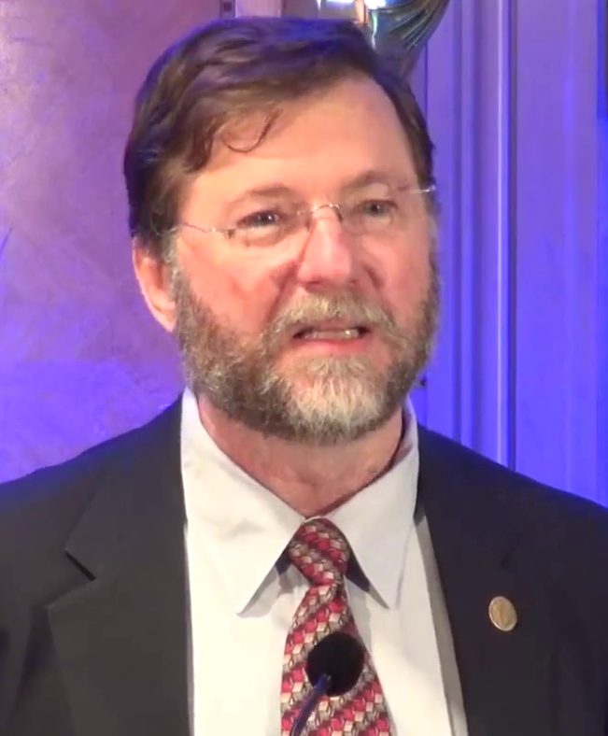
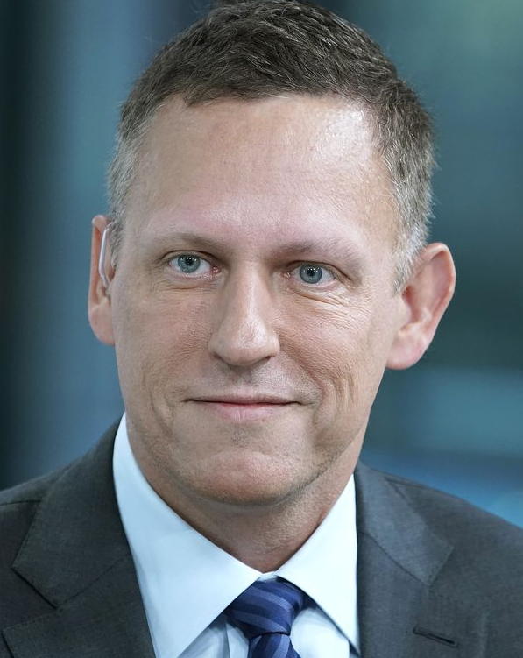
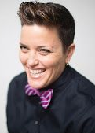
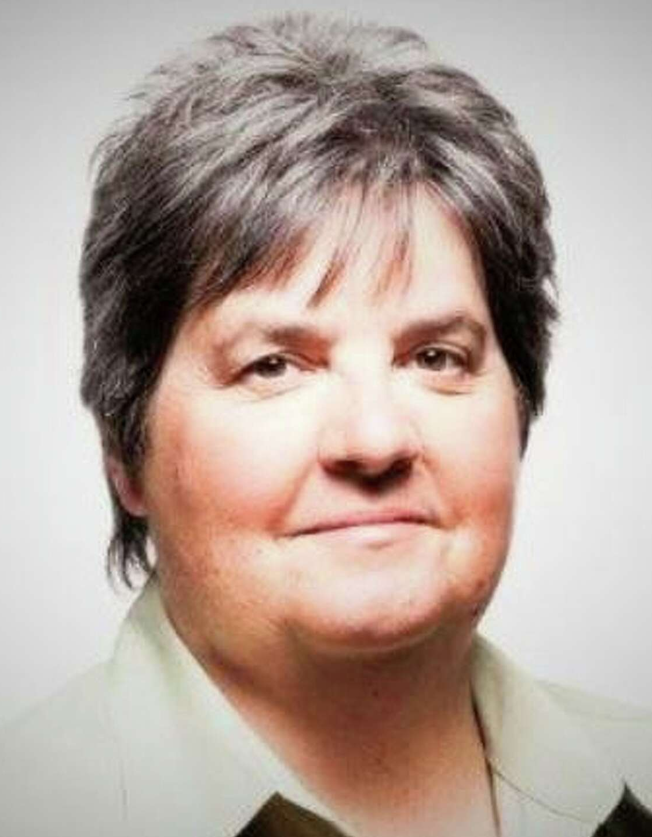
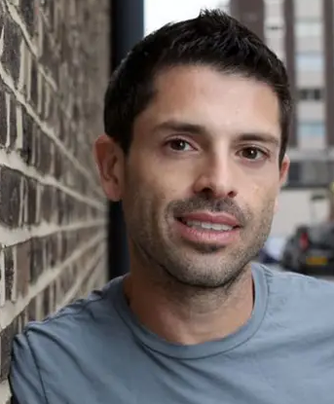
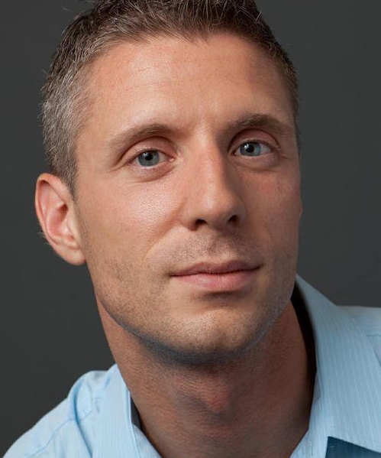
Chris Hughes:
Engineer and Facebook co-founder
Tim Cook:
Engineer and Apple CEO
Eric Allman: Inventor of sendmail and syslog systems
Peter Thiel: Tech investor & founder of Y Combinator
Sara Sperling: Facebook and Snapchat exec
Lisa Brummel: Microsoft VP of HR
Joel Simkhai: Social network entrepreneur
Lorenzo Thione: Founder of Bing predecessor
LGBT History Month Software Engineering luminaries honorable mentions (Photos: Bing)

Slide 2
Software Testing Exercise
JD Kilgallin
CPSC:480
11/02/22

Slide 3
Exercise
Clone the GitHub repo at https://github.com/kilgallin/SWEF22-Exercise-6
Create a branch named after your UANET Id.
Compute the cyclomatic complexity and runtime of each two-sum method and record the result in the provided comment above the function.
Write unit tests using the framework provided to verify behavior of the three two-sum methods.
Run the tests and check the code coverage and pass rate.
For any tests that don’t give the correct result on all methods, examine the two-sum method that’s failing and identify the cause of the failure.
Correct the failure(s) in the method so that all tests pass.
Ensure that you have 100% code coverage and 100% pass rate.
Commit & push your branch (git push --set-upstream origin <branch>)
Issue a pull request to main. Do not commit or merge to main.

